Slide 1
COMP718
Information Security Management
PROTECTING ASSETS AGAINST LOSS, MISUSE, DISCLOSURE OR DAMAGE

Slide 2
Lecture 1: Outline
Part 1:
  Motivation and the security landscape
Part 2:
  What is involved? What are we protecting?
Part 3:
  How to get there?

Slide 3
PART 1
MOTIVATION AND THE SECURITY LANDSCAPE

Slide 4
What is the definition of information security?
What essential protections must be in place to protect information systems from danger?
  Information Security is the protection of information and its critical elements, including the systems and hardware that use, store, and transmit the information.
  The elements of Information Security that must be in place to have "complete" security are:
    physical security
    personal security
    operations security
    communications security
    network security

Slide 5
Why do we need security management?
Changing technology
People and organizations
  Attackers
  Insiders
  Busy people
  Naïve People
Changing laws and other requirements

Slide 6
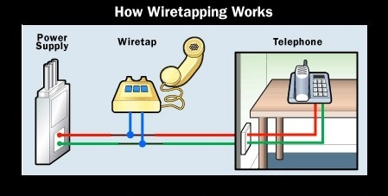
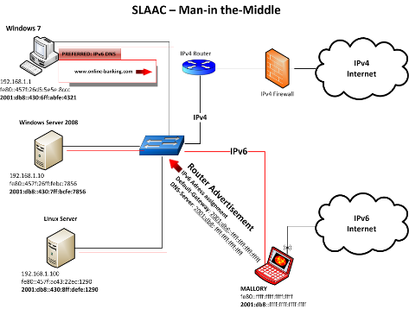
Simple framework for attacks
Attacks
?
?
Physical Access
Attacks
--
Wiretapping
Server Hacking
Vandalism
Social Engineering
--
Opening Attachments
Password Theft
Information Theft
?
Protocol Attacks
--
Eavesdropping
Impersonation
Message Alteration
?
Penetration
Attacks
Malware
--
Viruses
Worms
Denial of
Service
Break-in
Scanning
(Probing)

Slide 7
“A taxonomy of network and computer attacks”
By Simon Hansman and Ray Hunt, in Computers & Security, Volume 24, Issue 1, January 2005, Pages 31-43
  A more detailed classification system for information security
Four dimensions:
  The main attack means: virus, worms, buffer overflow…
  Targets of an attack: HW, SW, Network…
  Vulnerabilities and exploits used by an attack: configuration, implementation…
  Effects: data corruption, disclosure, loss of service…

Slide 8
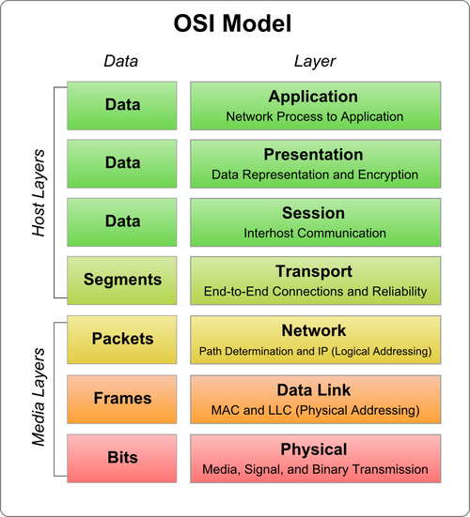
Layered approach
User Layer
Application Layer
Presentation Layer
Session Layer
Operating System
TCP Layer
Network layer (IP) Layer
Link Layer
Physical Layer

Slide 9
Attack targets have shifted
The proliferation of Web-based apps has exposed more kinds of software to attack
The culture of rapid change to web-server software makes it particularly vulnerable to attack
Network-based attacks have been brought under control through now-mature technologies such as firewalls, intrusion detection and prevention and other network-based control mechanisms
People are now attacking through applications, because it's easier than through the network layer. According to research by Gartner and Symantec, close to 90 percent of attacks are now aimed at the application layer

Slide 10
CSI Computer Crime & Security Survey
Conducted by the Computer Security Institute
Based on replies from over 500 computer security professionals (US focus)
Some key findings:
  Viruses continue as the source of the greatest financial losses
  Great increase in website incidents
  Information security outsourcing has not increased in popularity
  Incidents are less likely to be reported to law enforcement
  87% of organisations conduct security audits

Slide 11

http://www.privacyrights.org/
The Privacy Rights Clearinghouse (PRC) is a non-profit consumer organization with a two-part mission -- consumer information and consumer advocacy. It was established in 1992 and is based in San Diego, California. It is primarily grant-supported and serves individuals nationwide.
The PRC's goals are to:
  Raise consumers' awareness of how technology affects personal privacy.
  Empower consumers to take action to control their own personal information by providing practical tips on privacy protection.
  Respond to specific privacy-related complaints from consumers, intercede on their behalf, and, when appropriate, refer them to the proper organizations for further assistance.
  Document the nature of consumers' complaints and questions about privacy in reports, testimony, and speeches and make them available to policy makers, industry representatives, consumer advocates, and the media. (See list of Data Breaches)
    Look up for example: Cardsystems, TJX, CVS Pharmacies
  Advocate for consumers' privacy rights in local, state, and federal public policy proceedings, including legislative testimony, regulatory agency hearings, task forces, and study commissions as well as conferences and workshops.

Slide 12
Companies are reluctant to talk about security breaches unless required to by regulations.
However, most countries have no such laws, so incidents tend to be vastly under reported.
California's Database Security Breach Notification Act (SB 1386), which requires anyone doing business with California residents to disclose any security breach of unencrypted, personally identifiable information that was likely viewed or acquired by an unauthorized person.

Slide 13
Part 2
WHAT IS INVOLVED?
WHAT ARE WE PROTECTING?

Slide 14
The security equation
We have:
  Threats and risks (R)
    Example: web-site content is replaced
  Vulnerabilities (V)
    Example: a security hole in the web-server software
  Exploitations and attacks (A)
    Example: someone discovers the security hole and uses this information to replace the web-site content
  Tools, techniques and processes (T)
    Example: firewalls, software patches, intrusion detection systems
Attacks are materialised threats that are enabled by the vulnerabilities

Slide 15
What are we protecting?
  Confidentiality
  Integrity
  Availability
  Privacy
  Identification / authentication?
  Authorization
  Accountability (Non-Repudiation)
  How would you define these information characteristics and processes? What threatens them?
  How could you protect them?

Slide 16
Key Concepts of
Information Security
Confidentiality
  The characteristic of information whereby only those with sufficient privileges may access certain information
Measures used to protect confidentiality
  Encryption and Decryption
  Information classification
  Secure document storage
  Application of general security policies
  Education of information custodians and end users

Slide 17
Key Concepts of
Information Security (cont’d.)
Integrity
  The quality or state of being whole, complete, and uncorrupted
Information integrity is threatened
  If exposed to corruption, damage, destruction, or other disruption of its authentic state
Corruption can occur while information is being compiled, stored, or transmitted
Measures used to protect Integrity
    - Digital signature, MAC, MD, hash functions, security policy etc.

Slide 18
Key Concepts of
Information Security (cont’d.)
Availability
  The characteristic of information that enables user access to information in a required format, without interference or obstruction
  A user in this definition may be either a person or another computer system
  Availability does not imply that the information is accessible to any user
    Implies availability to authorized users
Measures used to protect Availability
  - Preventing DoS, DDoS, physical protection, access control

Slide 19
Key Concepts of Information Security (cont’d.)
Privacy
  Information collected, used, and stored by an organization is to be used only for the purposes stated to the data owner at the time it was collected
  Privacy as a characteristic of information does not signify freedom from observation
    Means that information will be used only in ways known to the person providing it

Slide 20
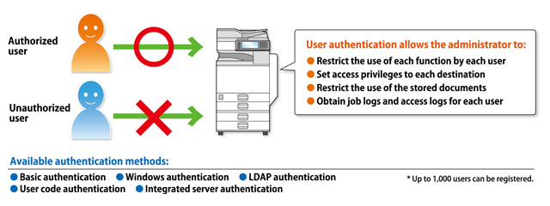
Key Concepts of Information Security (cont’d.)
Identification
  An information system possesses the characteristic of identification when it is able to recognize individual users
  Identification and authentication are essential to establishing the level of access or authorization that an individual is granted
Authentication
  Occurs when a control proves that a user possesses the identity that he or she claims
Notes:
Picture: https://www.google.co.nz/search?q=Authentication+management&source=lnms&tbm=isch&sa=X&ved=0ahUKEwjk2sWq9YzLAhWJI5QKHfhvD3cQ_AUIBygB&biw=1680&bih=939#imgrc=-PTaLBF8EZ8jOM%3A

Slide 21
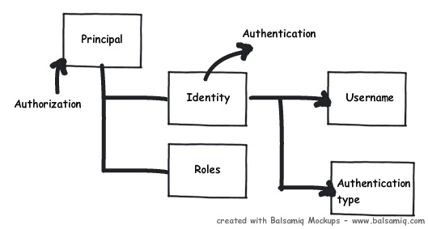
Key Concepts of Information Security (cont’d.)
Authorization
  Assures that the user has been specifically and explicitly authorized by the proper authority to access, update, or delete the contents of an information asset
  User may be a person or a computer
  Authorization occurs after authentication
Notes:
Picture: https://www.google.co.nz/search?q=Authorization&source=lnms&tbm=isch&sa=X&ved=0ahUKEwiaiZrX9IzLAhWJVZQKHVEbCfMQ_AUIBygB&biw=1680&bih=939#imgrc=ZBKSn8R6MxsA7M%3A

Slide 22
Key Concepts of Information Security (cont’d.)
Accountability (Non-Repudiation)
  Exists when a control provides assurance that every activity undertaken can be attributed to a named person or automated process

Slide 23
Security is not an ON/OFF situation
Security Requirement | No Criterion Security is not necessary | Advisable A certain degree of security is appreciated | Important Security is absolutely necessary | Essential Security is a primary criterion
Confidentiality | Public May be published | Protected Data only to be seen by a specified group | Crucial Data only for directly involved | Mandatory Severe damage on disclosure
Integrity | Passive No extra protection needed | Active Business process tolerates some errors | Detectable A very small number of error is permitted | Essential Demands error-free information
Availability | Unnecessary No Guarantees required | Necessary Occasional downtime is acceptable | Important Hardly any downtime during operating hours | Essential Unavailable only in extreme circumstances

Slide 24
PART 3
HOW TO GET THERE?
THE NON-TECHNICAL & TECHNICAL ASPECTS

Slide 25
Note on added value
Common negative management attitudes:
  Costs, but no direct benefits (“short term” attitude)
  No threat or vulnerability has materialised (“chicken and egg”)
  Probably won’t happen to my system (“statistician”)
  High level of protection does not protect from all possible threats (“all or nothing”)
  Lack of interest (“not my job – I don’t understand this computing stuff”)
Opposite almost guarantees success!

Slide 26

Security provides added value
Security provides added value for an asset
  Information is:
    Available when needed
    Stays confidential
    Correct
Not all systems are equally important
  “Tailored security” to meet business needs
  A balance between measures and resources!
  Resources: time, people, money

Slide 27
How to get there?
Lets start with the non-technical

Slide 28
Information Security Management (von Solms)
Attempts to comply with a code of practice categories:
  Security Policy
  Security Organisation
  Assets Classification and Control
  Personnel Security
  Physical and Environmental Security
  Computer and Network Security
  System Access Control
  System Development and Maintenance
  Business Contingency Planning
  Compliance and Audits
  BYOD, Cloud & Data Protection
Rossouw von Solms (1998) Information security management: Why information security is so important, Information Management & Computer Security, 6(4), pp.174 – 177.

Slide 29
What security measures are needed?
The Plan—Protect—Respond Cycle
  More on this later…
Planning
  Need for comprehensive security (no gaps)
  Risk analysis
    Enumerating threats
    Threat severity = estimated cost of attack X probability of attack
    Value of protection = threat severity – cost of countermeasure
    Prioritize countermeasures by value of protection

Slide 30
Compliance & Auditing
Are policies, standards and procedures being followed?
Establish ownership and owners of the components of the security program
Maintain an audit function

Slide 31

Security measures
Levels based on specific commitment
Reduce or eliminate risk
Starting point: The Security Organisation
  Provides:
    Clear responsibilities and tasks
    Guidelines
    Reporting procedures
  Maintains balance of measures
Other components of Security Measures:
  Physical, Technical, Procedural

Slide 32
Who is interested?
An organization’s three communities of interest that engage in efforts to solve Information Security problems.
  Information security community - Information security managers and professionals; Standards
  Information technology community - Information security technology mangers and professionals
  General business community - Nontechnical managers and professionals

Slide 33






Security layers
Clear specification of responsibilities, powers and duties in reducing level of abstraction:
  Policy and Codes of conduct
    objectives we are aiming to
  Processes
    what has to happen to achieve the objectives
  Procedures
    who does what and when
  Work instructions / workflow
    what, when and where is exactly done

Slide 34
Security organisation (Viewpoints)
1.High level overview:
  includes assessing the organisation of the security function, the security plan, policies, standards and procedures, risk-related programs
2. Security Operations overview:
  Includes monitoring, computer virus controls, compliance with the laws and regulations
3. Computer Operations overview:
  Includes access control, backup and recovery, problem management
4. Specific applications, databases, networks, operating systems, telecommunications

Slide 35
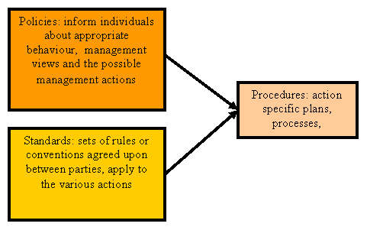
Clarification on terminology

Slide 36
Security organization and infrastructure
Chief Information Security Officer (CISO)
Business
security
coordination
Technical
security
coordination
Security
research
and
development
Security
administration

Slide 37
What is Management?
The process of achieving objectives using a given set of resources
Manager
  Someone who works with and through other people by coordinating their work activities in order to accomplish organizational goals

Slide 38
What is Management? (cont’d.)
Managerial roles
  Informational role
    Collecting, processing, and using information that can affect the completion of the objective
  Interpersonal role
    Interacting with superiors, subordinates, outside stakeholders, and other parties that influence or are influenced by the completion of the task
  Decisional role
    Selecting from among alternative approaches, and resolving conflicts, dilemmas, or challenges

Slide 39
What is Management? (cont’d.)
Leaders vs. Managers?
Leaders
  Influence employees to accomplish objectives
  Lead by example; demonstrating personal traits that instill a desire in others to follow
  Provide purpose, direction, and motivation to those that follow
Managers
  Administers the resources of the organization
  Creates budgets, authorizes expenditures and hires employees

Slide 40
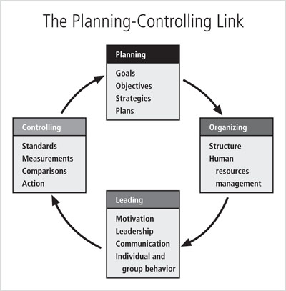
Management Characteristics
Figure 1-3 The planning-controlling link
Source: Course Technology/Cengage Learning (adapted from Jourdan, 2003)

Slide 41
In summary: Security is pervasive and…
Primarily a management issue, not a technology issue!
Security also has a human aspect:
For example awareness training:
Educate employees to recognise their responsibilities
Educate employees to understand the value of information security
Educate employees to recognise potential violations, contact points
Maintain a high level of security awareness

Slide 42
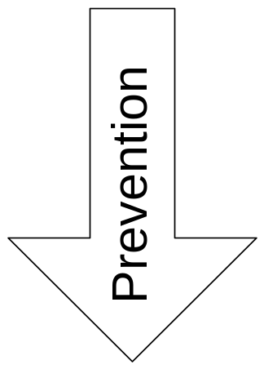
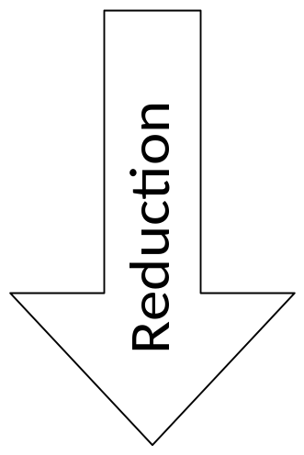
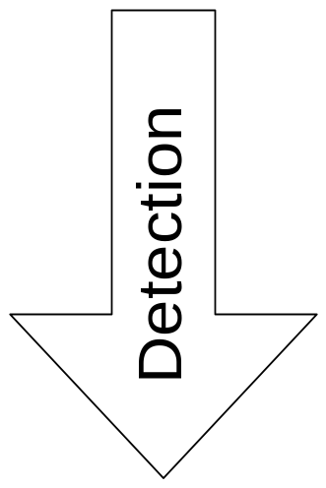
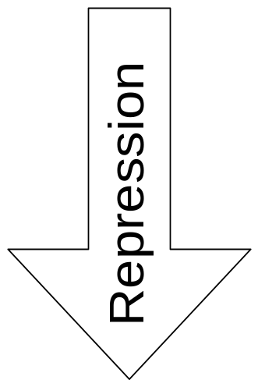
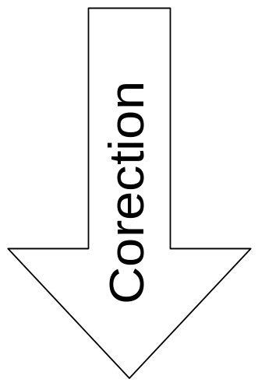
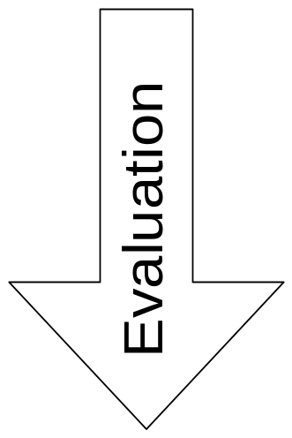
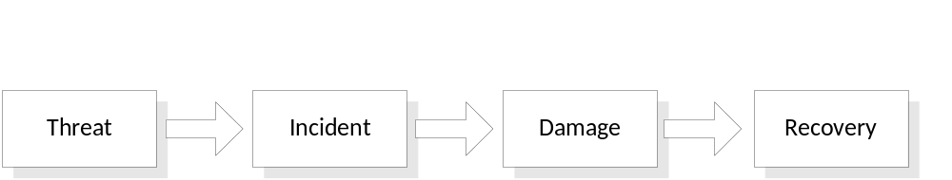
The Operational Security Life-Cycle
Manages and maintains a proper balance of measures
Different measures for different stages of prevention and handling of incidents

Slide 43
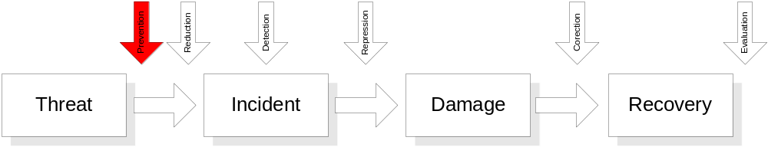
Preventive Measures
?
For example:
  Measure: allocation of access rights
    The control of access rights (granting, changing, removing)
    Authorisation (who, what, how)
    Identification -> authentication (who is seeking access)
    Access control (enforcing access control)

Slide 44
Note on authentication & passwords
Can password “security level” be too high?
At the start of the day a user:
  Login the network, e-mail, CRM system, helpdesk application
Logins expire every hour
  Checks that same PW is not used in any system
  Requires password changes monthly/weekly/daily
  Check that the new PW is not any of the previous used
Is this a desirable situation?
  Productivity will drop due to forgotten PWs, increase in helpdesk requests
  Forces users to write down PWs
  Security measures are seen as a hindrance

Slide 45
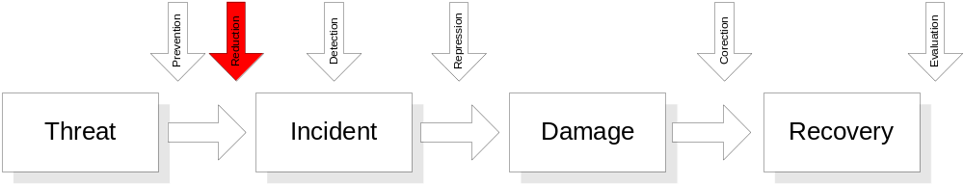
Reductive measures
?
For example:
  Making regular backups
  Development, testing and maintenance of contingency plans

Slide 46
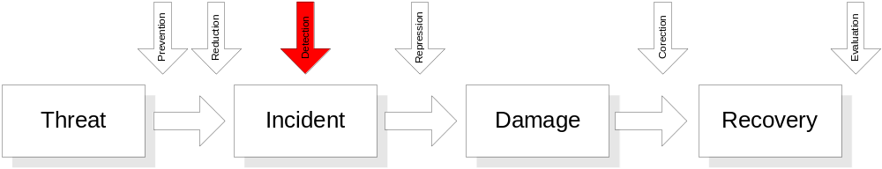
Detection measures
?
Discovery of an incident as soon as possible
For example: virus checking with alerts, intrusion detection systems

Slide 47
Note on detection measures
Is the database data correct
Detection of a fault today → restore yesterday’s backup?
How far can you see?

Slide 48
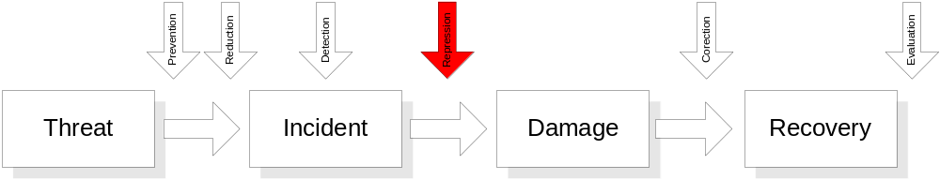
Repressive measures
?
Aimed to counteract continuation and repetition of the incident
For example: blocking of accounts, network addresses etc.

Slide 49
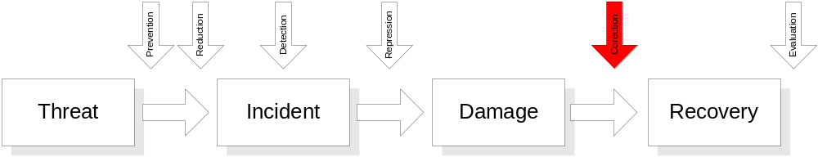
Corrective measures
?
To fix the damage as far as possible
For example: restoring backups, returning to previous stable situation (roll back)

Slide 50
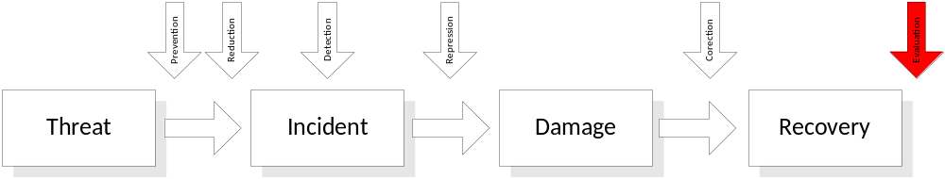
Evaluation
In case of a serious incident to:
  Determine what went wrong
  How to prevent it in the future
  Reporting for all incidents to gain a full picture of the effectiveness of security measures

Slide 51
How about new projects?
Most important for security?
Clearly defining project security requirements.
  Who are the stakeholders?
  What data is involved?
  How is the data classified?
  What systems are involved?
  What are their weaknesses?
  Get involved from day 1

Slide 52
International policy frameworks
Let’s look to best practice…

Slide 53
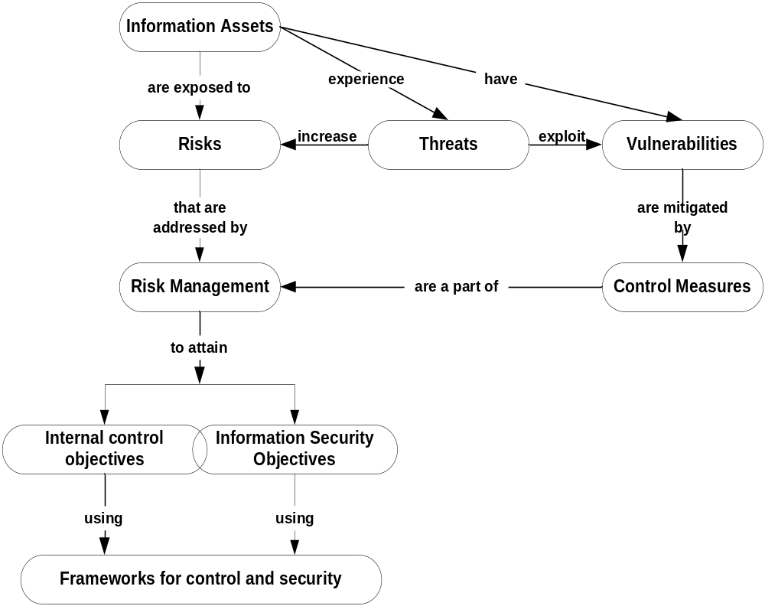

Slide 54
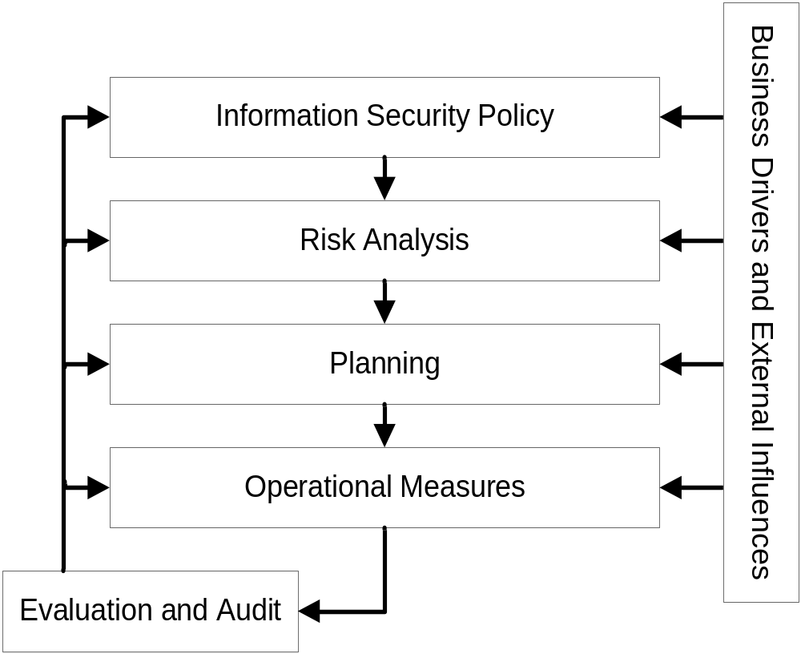
ITIL Information Security Responsibilities
Customers:
Policy and risk analysis are customers’ responsibility to identify
IT service provider:
Focus on the lower level elements
Deliver to a defined security service level

Slide 55

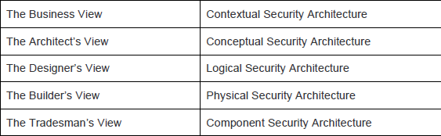
SABSA Security Architecture
(the complex view) https://en.wikipedia.org/wiki/Sherwood_Applied_Business_Security_Architecture
Similar to Zachman’s Enterprise Architecture Model (http://en.wikipedia.org/wiki/Zachman_Framework)
Stands for: Sherwood Applied Business Security Architecture
Please see the reading in the BB course page for a detailed description
Layered views:

Slide 56
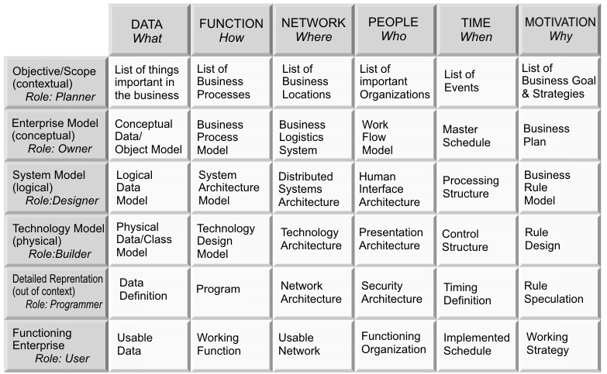
The Zachman model

Slide 57
Like creating a new building…
Owner: purpose and social function of the building
Architect: grand vision of the building
Designer: detailed work turning the vision into plans that can be used to build the building
Builder: turns the structural plans in to a building plan.
Tradesman: the experts on how to implement sub-parts of the building plan
Building Manager: runs the building once taken into use

Slide 58
Business view: (contextual security architecture)
What? The business, its assets to be protected (brand, reputation, etc.) and the business needs for information security (security as a business enabler, secure electronic business, operational continuity and stability, compliance with the law, etc.). In terms of the highest level of information architecture this is expressed as ‘business decisions’, along with business goals and objectives.
Why? The business risks expressed in terms of business opportunities and the threats to business assets. These business risks drive the need for business security (enabling eBusiness, brand enhancement and protection, fraud prevention, loss prevention, fulfilling legal obligations, achieving business continuity, etc.).
How? The business processes that require security (business interactions and transactions, business communications, etc.).
Who? The organisational aspects of business security (governance and management structures, supply chain structures, out-sourcing relationships, strategic partnerships), including a definition of the ‘extended enterprise’, which includes all business partners and external relationships.
Where? The business geography and location-related aspects of business security (the global village market place, distributed corporate sites, remote working, jurisdictions, etc.).
When? The business time-dependencies and time-related aspects of business security in terms of both performance and sequence (business transaction throughput, lifetimes and deadlines, just-in-time operations, time-to-market, etc.).

Slide 59
Architect’s View: (conceptual security architecture)
What you want to protect
Why the protection is important, in terms of control and enablement objectives
How you want to achieve the protection, in terms of high-level technical and management security strategies and a process-mapping framework through which to describe business processes and enablement objectives
Who is involved in security management, in terms of roles and responsibilities and the type of business trust that exists between the parties, including asset owners, custodians and users, and service providers and service customers.
Where you want to achieve the protection conceptualised in terms of a security domains framework.
When is the protection relevant, expressed in terms of a business time-management framework.

Slide 60
Designer’s View: (Logical Security architecture)
:
What? Business information is a logical representation of the real business. It is this business information that needs to be secured.
Why? Specifying the security and risk management policy requirements (high-level security policy, registration authority policy, certification authority policy, physical domain policies, logical domain policies, etc.) for securing business information.
How? Specifying the logical security services (entity authentication, confidentiality protection, integrity protection, non-repudiation, system assurance, etc.) and how they fit together as common re-usable building blocks into a complex security system that meets the overall business requirements.
Who? Specifying the entities (users, security administrators, auditors, etc.) and their inter-relationships, attributes, authorised roles and privilege profiles in the form of a ‘schema’, and the trust that exists between them in the form of a trust framework.
Where? Specifying the security domains and inter-domain relationships (logical security domains, physical security domains, security associations).
When? Specifying the security-related calendar and timetable in terms of start times, deadlines and lifetimes (such as for registration, certification, login, session management, etc.).

Slide 61
Builder’s View: (Physical Security Architecture)
What? Specifying the business data model and the security-related data structures (tables, messages, pointers, certificates, signatures, etc.)
Why? Specifying rules that drive logical decision-making within the system (conditions, practices, procedures and actions).
How? Specifying security mechanisms (encryption, access control, digital signatures, virus scanning, etc.) and the physical applications, middleware and servers upon which these mechanisms will be hosted.
Who? Specifying the people dependency in the form of the human interface (screen formats and user interactions) and the access control systems.
Where? Specifying security technology infrastructure in the form of the host platforms and the networks (physical layout of the hardware, software and communications lines).
When? Specifying the physical time management in terms of the timing and sequencing of processes and sessions (sequences, events, lifetimes and time intervals).

Slide 62
Tradesman’s View: (Component security Architecture)
What? ICT components such as ICT products, including data repositories and processors.
Why? The risk management-related tools and products such as risk analysis tools, risk registers, risk monitoring and reporting tools.
How? Process tools and standards (tools and protocols for process delivery - both hardware and software).
Who? Personnel management tools and products (identities, job descriptions, roles, functions, actions and access control lists).
Where? Locator tools and standards (nodes, addresses, and other locators).
When? Step timings and sequencing tools (time schedules, clocks, timers and interrupts).

Slide 63
Service Manager’s View:
What? Service delivery management (assurance of operational continuity and excellence of the business systems and information processing, and maintaining the security of operational business data and information).
Why? Operational risk management (risk assessment, risk monitoring and reporting, and risk treatment so as to minimise operational failures and disruptions).
How? Process delivery management (management and support of systems, applications and services, performing specialised security-related operations such as user security administration, system security administration, data back-ups, security monitoring, emergency response procedures, etc.).
Who? Personnel management (account provisioning and user support management for the security-related needs of all users and their applications, including business users, operators, administrators, etc.).
Where? Management of the environment (management of buildings, sites, platforms and networks).
When? Management schedule (managing the security-related calendar and timetable).

Slide 64
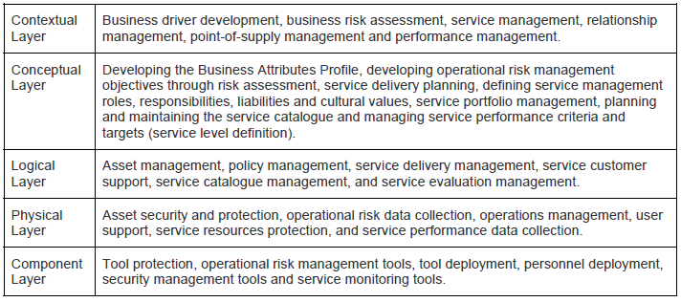
The Service Manager’s view covers all layers
The Security Service Management Architecture

Slide 65
Other views:
Inspector’s View
Governor’s View
These are aspects of the Service Manager’s view, that cross over all of the layers.

Slide 66
Business drivers for Information Security
Security can be a business enabler, not only a cost:
Digital businesses: eBanking, eProcurement, eGovernment, Consulting
Operational Continuity and Stability
  Revenue generation; Customer service; Market reputation; Management control; Operating licenses; Employee confidence; Shareholder confidence; Other stakeholders
Safety of critical systems (Health & Safety)
  Operating systems correctly: plant automation
  Systems assurance: ensuring the design of systems

Slide 67
Business drivers for Information Security
Business goals, success factors and operational risks
  Brand protection; Fraud prevention; Loss prevention; Business continuity; Strategic business development; Legal obligations; Confidence of key stakeholders
Operational risk assessment
  Risk modelling
  Risk assessment
  Threat modelling framework
  Threat domains: people, processes, systems, external events

Slide 68
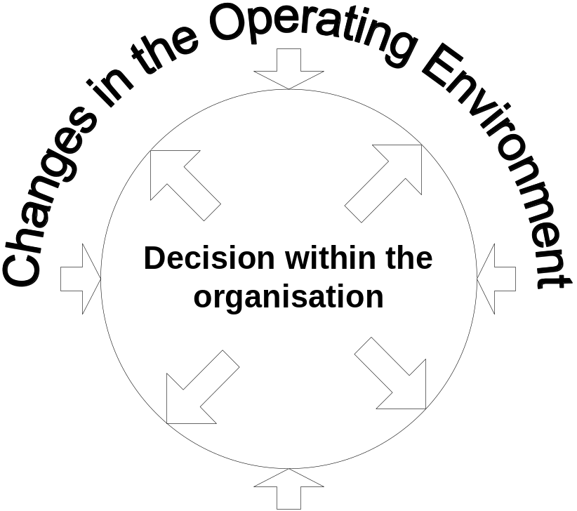
All of that said and implemented…
Are we done? No…Security is an iterative process
  Internal and external influences:
  Moving premises
  New markets
  Fast growth
  Changes in nature of business
  Legal changes
  HW & SW changes
  New threats & risks
  …
?

Slide 69
Readings & Assessment
  Chapter 1, “Introduction to the Management on Information Security” from Whitman, M. & Mattord, H. (2010) “Management of Information Security” , ed. 3. Cengage.
  Assessment: Quiz 1, lecture class, week 2 ( 7 March 2018)

